Slide 1
The SMP Program: Protect Yourself from Healthcare Fraud

Slide 2
The SMP Program – Senior Medicare Patrol
www.illinoissmp.org

Slide 3
Who Are We?
In Illinois, the Senior Medicare Patrol (SMP) program is administered by AgeOptions in partnership with a network of statewide aging service agencies.
The SMP program empowers Medicare beneficiaries on how to protect, detect, and report fraud.
The Administration for Community Living (ACL) provides funding to SMP programs in all 50 states, Washington, D.C., Puerto Rico, Guam, and the Virgin Islands.
ACL and the SMP Program are working in partnership with the U.S. Department of Health and Human Services and the U.S. Department of Justice to fight Medicare fraud.
Notes:
-Make sure we emphasize that SMP is a statewide program and we have partners throughout the state.
-State who we are funded by and what we use funding for (empower beneficiaries to protect, detect, and report healthcare fraud).

Slide 4
What We Will Cover
Define healthcare fraud and errors.
Learn how to properly read a Medicare Summary Notice (MSN) and what to look for in order to detect fraud.
Talk about why it is important to report fraud and how it impacts people in the community.
Take a closer look at specific examples of healthcare fraud.
Time for Questions.
Notes:
-Be very specific and emphasize the differences between fraud and error. We want to point out that errors happen in billing on Medicare/providers end.

Slide 5
What is Healthcare Fraud?
Potential healthcare fraud
Billed for a service you did not receive
Billed for something different than what you have received
Billed for something you that was not medically necessary
Billing for the same service or piece of equipment twice
Notes:
-Emphasize the word potential. We never want to say something is definitively fraud unless the OIG has proof.
-We should not be putting in beneficiaries minds that something is definitely fraud. Always use the phrase ‘potential fraud’.

Slide 6
What are Healthcare Billing Errors?
Billing errors
Human mistake
Accidentally entering the wrong name or information
If the error is a human error and not fraud, work with the provider to rectify the error
Notes:
-Make it clear that Medicare goes through thousands of claims each day and it is highly possible that human error occurs when entering data.
-Make sure beneficiaries take the time to contact the provider to see if they can resolve the error before contacting their local SMP.

Slide 7
Check Your Knowledge-Question 1
The definition of ____ is when someone intentionally deceives or makes misrepresentations to obtain money or property of any healthcare benefit program.
A. Fraud
B. Error
Notes:
-Emphasize the word ‘intentionally’. Fraud is when a supplier or provider knowingly commits fraud. Error is unintentional.
-Try to be interactive with the audience for ‘Check your knowledge’ questions. We want to keep attendees engaged in the presentation and do not want to simply read through the PowerPoint quickly.

Slide 8
Correct Answer
A. Fraud
The answer is fraud because an error is considered unintentional and can be easily fixed with the help of Medicare.
Fraud is an intentional act of billing for services not provided, services not medically necessary, or billing for the same thing twice.
Notes:
-Again, emphasize the possibility of ‘unintentional’ billing errors.
-If something is suspicious or POTENTIAL fraud, discuss the difference between the two.

Slide 9
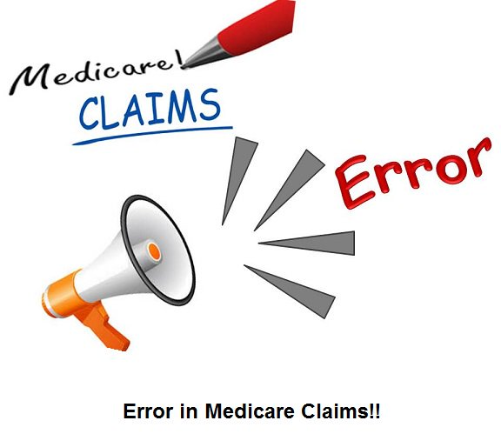
Check Your Knowledge- Question 2
Billing errors will always indicate a healthcare provider’s or supplier’s intent to commit fraud.
A. True
B. False
Notes:
-Emphasize the word ‘always’. Errors does not mean that a provider is always intending to commit fraud. Human mistakes happen, this does not necessarily mean someone is attempting to commit fraud against a beneficiary.

Slide 10
Correct Answer
B. False
The correct answer is false. It is very possible that billing errors occur through Medicare without the intent of fraud.
Medicare processes thousands of claims, making beneficiaries’ Medicare susceptible to error.

Slide 11
How Much is Lost?
How much do you think is lost every year to healthcare fraud and abuse?
A) $5-10 million
B) $25-125 million
C) $10-20 billion
D) $60-100 billion
Eaton, J. 2018. “Medicare Under Assault From Fraudsters”. AARP Bulletin. Retrieved from: https://www.aarp.org/money/scams-fraud/info-2018/medicare-scams-fraud-identity-theft.html
Notes:
-Give a couple seconds to let the audience think about this question.
-Do not answer it for them, make sure you ask the audience and try to have people answer.

Slide 12
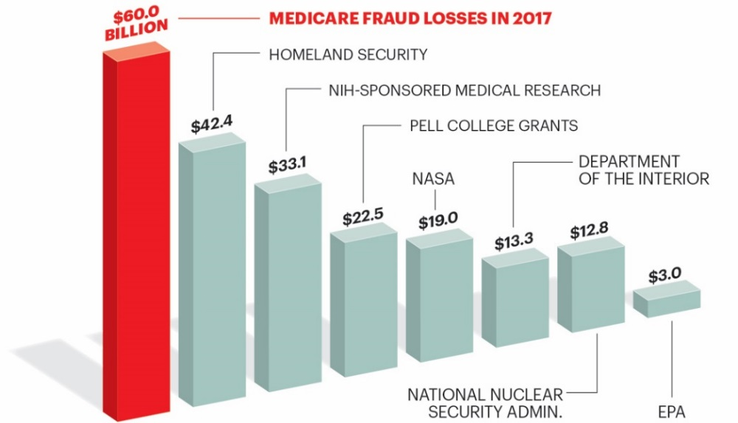
Correct Answer
D. $60 Billion
In 2017, over $60 billion was lost to Medicare fraud, beating out the amount of Homeland Security, medical research, college grants, and more.
Eaton, J. 2018. “Medicare Under Assault From Fraudsters”. AARP Bulletin. Retrieved from: https://www.aarp.org/money/scams-fraud/info-2018/medicare-scams-fraud-identity-theft.html
Notes:
-Make sure you not only read the correct answer, but account for all the other costs that Medicare fraud beats out.

Slide 13
The SMP Message
1.) Protect
2.) Detect
3.) Report
Notes:
-State the SMP message. Protect, detect, and report and state that we will discuss each of these steps.

Slide 14
STEP 1: PROTECT
Notes:
-The first step of the SMP process is how to protect yourselves against healthcare fraud.

Slide 15
PROTECT Yourself From Fraud!
DO
Educate yourself on Medicare fraud.
Protect your Medicare card and Social Security number.
Use a calendar or personal healthcare journal to record all your doctors visits and services.
Report suspicious activity to the Illinois SMP.
Notes:
-”Educate yourselves on Medicare fraud. By being here today you are taking the right steps toward informing yourself and others on how to avoid fraud.”
-Explain that the old Medicare cards should be shredded because they are their old Social Security Numbers.
-Define what a personal healthcare journal is or state how to use a notepad to keep track of appointments and services received.
-If they need to report suspicious activity to the SMP, let them know the SMP number is in this presentation.

Slide 16
PROTECT Yourself From Fraud!
DO NOT
Do not give your Medicare card, Medicare Number, Social Security card, or Social Security Number to anyone except your doctor or people you know should have it.
Do not accept medical supplies or services from a door-to-door salesman or someone calling over the phone.
Do not allow anyone, except your doctor or other Medicare providers, to review your medical records or recommend services.
Notes:
-Explain how important it is to only trust and work with their main care providers.
-Tell beneficiaries to hang up and never give their information away over the phone. If anyone is offering ‘free’ DME or services, it is NOT free!

Slide 18
DETECT Fraud!
Read your Medicare Summary Notice or Explanation of Benefits from your insurance company. Watch for:
Services or equipment that you did not receive
Services or equipment that were not ordered by your doctor
Billing for the same thing twice
Other billing errors
Notes:
-Explain that a MSN is similar to an EOB.
-Emphasize the importance of carefully looking out for suspicious activity.
-Once beneficiaries receive their MSN or EOB, is when to compare one’s personal healthcare journal to ensure there is nothing on there that should not be.

Slide 19
DETECT Fraud!
Medicare Summary Notices (MSNs) are mailed quarterly (once every three months).
You can always request a Medicare Summary Notice by calling 1-800-Medicare.
You can also view your eMSN monthly by logging into: www.MyMedicare.gov.
Notes:
-Make sure beneficiaries know that if they suspect something suspicious is occurring or they receive a phone call scam and do not want to wait another 3 months for their next MSN or EOB to be mailed, they can call 1-800-MEDICARE or they can log in to www.MyMedicare.gov to receive and electronic MSN.

Slide 20
How to Read Your MSN-Page 1
This is what the first page on an MSN looks like.
You may see the statement “THIS IS NOT A BILL” Your MSN is not a bill, it is a summary of your claims for the period.
It is still important to review your MSN and look for any signs of possible fraud.
Notes:
-Emphasize that a beneficiaries MSN or EOB is NOT a bill.
-Explain what to look for on the first page of an MSN to spot an suspicious activity: date of claims this period (make sure they match dates of services you have received), ‘Did Medicare approve all services?’, ‘Providers with claims this period’ (look if there are any providers you do not recognize.

Slide 21
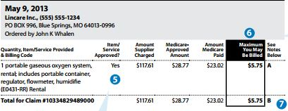
How to Read Your MSN
Your MSN lists claims that were billed to Medicare, how much Medicare paid, and how much you might be billed.
A brief description of the service performed will be listed for each claim. Make sure this description matches the services that you received.
Notes:
-

Slide 22
Learning Activity: What could possibly indicate fraud on Mike’s MSN?
Was he charged for any medical services he didn’t receive?
Do the dates of services look unfamiliar?
Was he billed for the same thing twice?
Is there something in his MSN that his doctor did not order?
Notes:
-Try to get the audience involved in this activity and let them answer the next page on their own with what to look at.

Slide 23
Page 3 of your MSN
Notes:
-Let the audience point out suspicious activity on this page.
-Urge the audience to explain WHY these items may be suspicious.
-Look for date of claims processed, who services were ordered by (do you recognize the provider?), what was ordered by the provider (did you or your doctor order an oxygen system, do you need one?)

Slide 24
STEP 3: REPORT

Slide 25
Reporting Fraud
If you suspect fraud or notice something suspicious on your MSN:
contact the Illinois SMP at AgeOptions at (800)699-9043.
Notes:
-Make sure again we are emphasizing POTENTIAL fraud. These next two slides we want to make sure we are differentiating between who to contact if we suspect fraud (SMP) and who to contact if we suspect a simple billing error (provider).

Slide 26
Reporting Errors
If you think there may be a billing or service error by your provider, please call the billing hotline of that provider or supplier and try to resolve this error as soon as possible.
If the provider will not explain or correct the error or you suspect fraud, call the Illinois SMP at AgeOptions at (800)699-9043.

Slide 27
Why it is Important to Report Fraud
Billions of taxpayers dollars, as well as your own, are going to waste each year due to Medicare and Medicaid fraud.
When equipment is sent fraudulently and not ordered by your doctor, it may harm your health.
Your Medicare benefits may be used up and in the future when you actually need services or equipment, it is possible Medicare does not approve a payment because it looks like you are already receiving that service.
Notes:
-The charges that Medicare covers may possibly not be recovered and the Medicare program may be used up in the future.
-Although a piece of equipment may have been sent fraudulently for ‘free’, the provider who ordered or sent it does not know your measurements and it may harm your health more.
-A lot of times people will not think it is important to report fraud because Medicare will still pay for a service/equipment a beneficiary didn’t need so they will not pay out of pocket, BUT really emphasize how important it is because in the future, when a beneficiary really needs a service Medicare may not cover it because they see the beneficiary may have received one in the past.

Slide 28
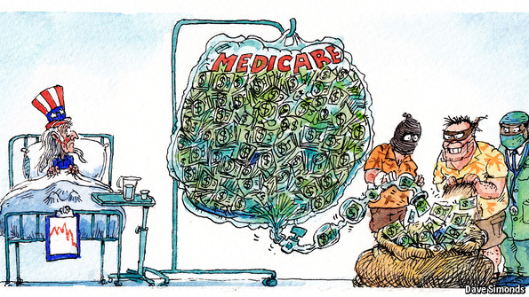
Examples of Healthcare Fraud
Simonds, D. “Investigators in New York looking for health-care hot-spots”. The Economist. Retrieved from: https://www.economist.com/taxonomy/term/76972/Britain%20and%20the%20European%20Union%20A%20sea%20of%20troubles?page=1357
Notes:
-”Now we will discuss examples of healthcare fraud and what instances to look out for.”

Slide 29
Example of Phone Call Scams
A person calls claiming to be from Medicare stating that you are eligible for free services.
The caller states all they need in return is your information, such as your Medicare number.
You then give away your Medicare number, but never receive those services or hear back from the caller.
What is not right in this situation? What should you do next?
Notes:
-Explain the importance of not giving away ANY information over the phone.
-Try and have the audience interact at the end of each example with the questions.

Slide 30
Example of Durable Medical Equipment (DME) Fraud
One day, your friend Mr. Smith received a call claiming to be from Medicare asking if he had back pain.
The caller asked for Mr. Smith’s Medicare number, which he gave to the caller. The next week, he received a back brace that his doctor did not prescribe and it did not fit him.
A month later, on his MSN, Mr. Smith saw that Medicare was charged over $1000.
What would you tell Mr. Smith to do next?
Notes:
-Give the audience a chance to answer the question at the bottom.
-Once the audience has had an opportunity to answer, explain all of the proper steps to report.

Slide 31
Example of Home Healthcare Fraud
To justify charging for a home health nurse, a physician who is not the beneficiary’s primary doctor falsely certified that the beneficiary is an insulin-dependent diabetic and cannot inject himself.
What can we look out for to prevent this?
How can we detect this fraud?
Notes:
-Relate this answer back to the SMP message (prevent, detect, and report).
-Once audience had the chance to answer, emphasize the importance of working with your doctor.
-Explain that home health requires a plan of care from main care providers. Home health should be carefully planned out with YOUR doctor on your specific needs.

Slide 32
Work With YOUR Doctor
If you need medical services or equipment, you and your doctor can make that decision- Your doctor knows your health needs!
Only give your Medicare number to your trusted doctor.
Your Medicare-enrolled doctor will write an order for services or equipment when it is medically necessary.
Notes:
-Remind audience the importance of working with their doctor (they know your medical needs).

Slide 33
If you or anyone you know would like to volunteer…
Volunteers are the key to spreading the SMP message!
Volunteers have the opportunity to present, as I am here today, and provide information and outreach.
For more information about volunteering with the Illinois SMP, please email us at volunteer@ageoptions.org or call
(800)699-9043
Notes:
-Describe briefly what our volunteers do and who to call if someone they know may be interested.

Slide 34
Questions?
Notes:
-Time for any questions.

Slide 35
Hotline Resources
Illinois SMP | 1-800-699-9043
Social Security Administration | 1-800-772-1213
Centers for Medicare/Medicaid | 1-800-MEDICARE
Better Business Bureau | 1-703-276-0100
Federal Trade Commission/Identity Theft Hotline | 1-877-438-4338
Eldercare Locator | www.eldercare.gov
Illinois Senior Health Insurance Program (SHIP) | 1-800-252-8966

Slide 36
Thank you!
If you have questions, contact the Illinois SMP at AgeOptions
(800)699-9043
This project was supported, in part by grant number 90MPPG0036, from the U.S. Administration for Community Living, Department of Health and Human Services, Washington, D.C. 20201. Grantees undertaking projects under government sponsorship are encouraged to express freely their findings and conclusions. Points of view or opinions do not, therefore, necessarily represent official ACL policy.
Notes:
-Thank the audience and point out on this page where SMP hotline is for state of IL complex interactions

